Slide 1
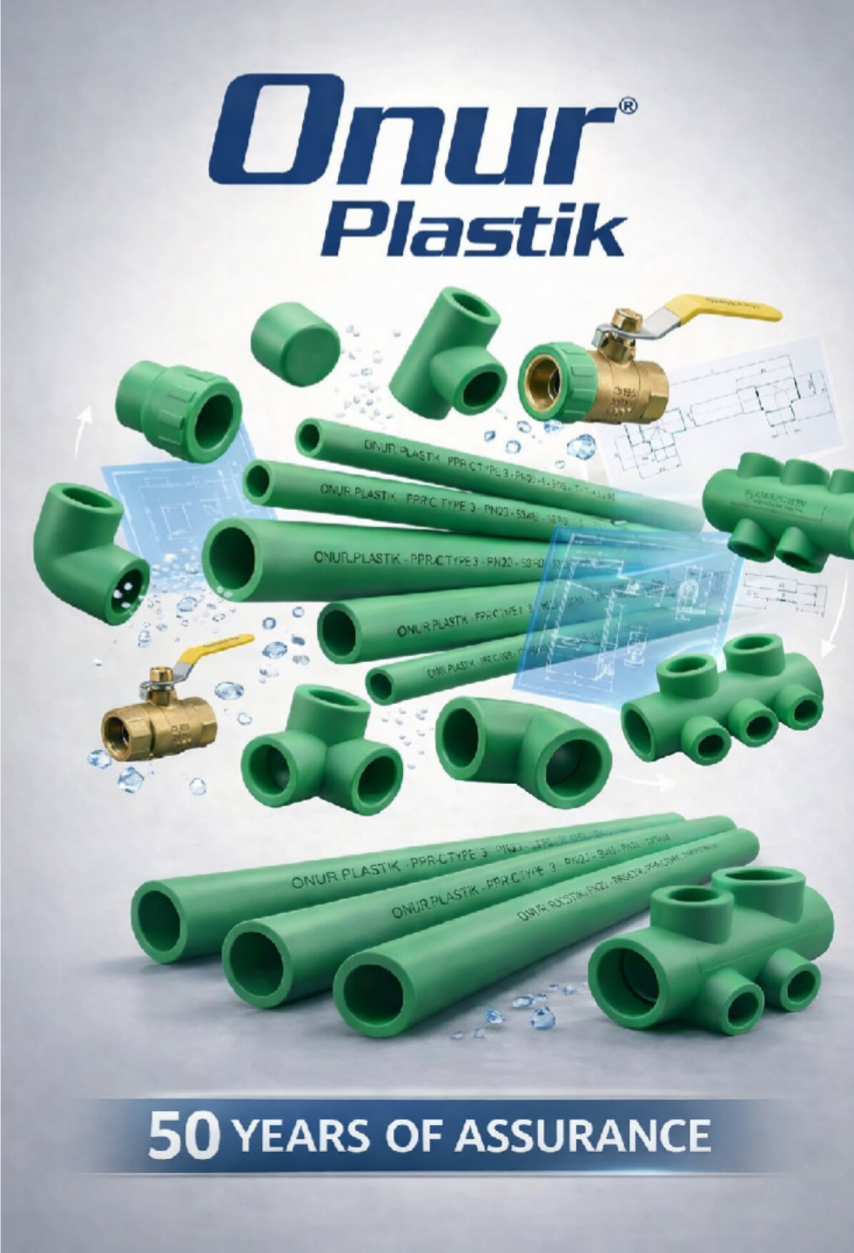
TRUST IN MANUFACTURING SINCE 1999.
ONUR FITTINGS & PLASTIC PIPES is a premium PPRC pipe and fittings manufacturer based in Istanbul, Türkiye, founded in 1999 by Dr. Adnan Akay and currently led by second-generation owner Akın Akay under the brand “ONUR PLASTİK.” We provide a 50-year warranty on our products.
Since our establishment, we have continued to deliver safe, high-quality, and hygienic water distribution systems to end users.
TRUST IS NOT A PROMISE; IT IS A DISCIPLINE REPRODUCED EVERY DAY.
Our field of activity is the manufacturing of pipes and fittings for plumbing and infrastructure applications.

Slide 2
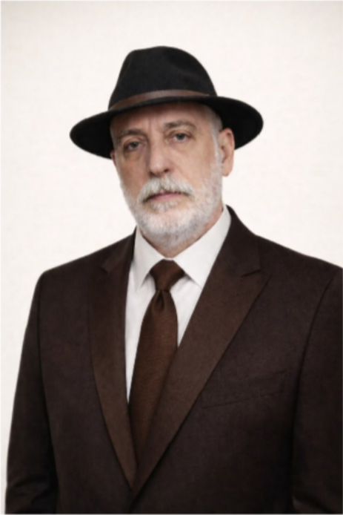
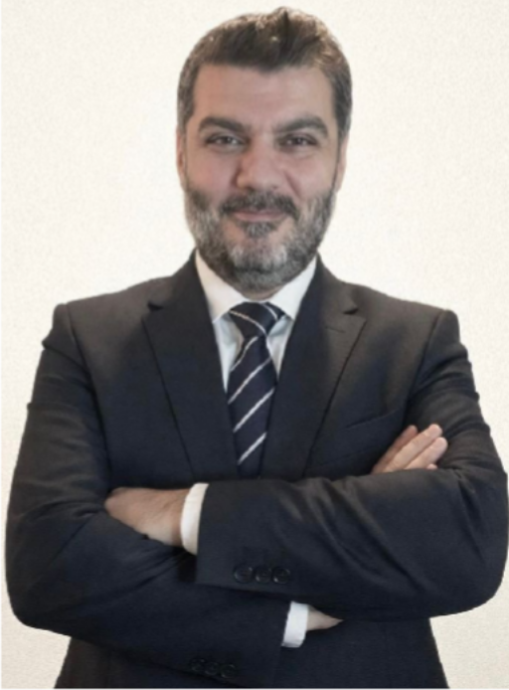
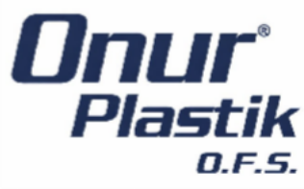
The Founders
Founder
Dr. Adnan AKAY
13 October 1961 / Malatya
Istanbul University – Cerrahpaşa Faculty of Medicine 1999–2013
General Manager Akın AKAY
25 September 1986 / Malatya
Doğuş University / Industrial Engineering 2013 – Present

Slide 3
We Are Building the Future Together
Corporate Transformation
Our Vision
In a world where every drop of clean water matters, to become the global reference point for safe water conveyance systems.
Our Mission
With every product we manufacture, we protect families’ health, contractors’ reputations, and the future of our communities. Trust is not a promise to us; it is a discipline reproduced every day.

Slide 4
Our Values
01
02
Trust — The Cornerstone
Our word comes before any contract. Our behavior is tested as much as our products. Trust is our most valuable raw material—once it’s lost, it cannot be manufactured again.
Consistency in Quality
Whatever the first batch is, the thousandth batch is the same. Quality should never be a surprise—and we never allow it to be. Our can place orders with complete confidence; we manufacture with full attention and discipline. That’s why we provide a 50-year warranty on our prcustomersoducts.
04
03
Transparency
We don’t hide—we manage. From numbers to processes, everything is visible. There are no hidden agendas inside, and we leave no grey areas outside. Our goal of going public is the ultimate proof of our commitment to transparency.
05
Ownership
We don’t make excuses—we deliver solutions. In success we say “we,” in mistakes we say “I.” Each of us thinks and acts like an owner of Onur Plastik.
06
Responsibility for the Future
End-User Mindset
We manufacture today with tomorrow’s world in mind. From At the end of every pipe, there is a family. We act as if the water
energy to waste, from packaging to logistics, we aim to leave as flowing from the tap will be consumed by our own child. Our
little trace as possible in every decision we make.
07
product may be invisible—but our responsibility is not.
08
Operational Discipline
Standards are not suggestions—they are non-negotiable. We choose the right way, not shortcuts. Undisciplined production leads to unsafe products.
09
Continuous Improvement
The day you say “done” is the day decline begins. We never say “good enough.” From machinery to management, from production to communication, we continuously improve everything we do.
10
Team Intelligence
We build championship teams, not star players. We don’t hoard knowledge—we share it. We elevate one another. Ego stays at the door; only “we” enters.
11
Speed & Agility
We move not to report problems, but to solve them. Problems that wait grow—ours shrink. Decision-making takes courage, and we act with courage.
12
Legacy & Continuity
We protect the founder’s effort and scale it as the second generation. The foundation Dr. Adnan Akay laid in 1999 is our compass. We draw strength from the past and invest in the future.
Ethical Backbone
We don’t do work that is profitable but wrong. Winning in the long run means being willing to lose in the short term. In our business relationships, honesty is never up for negotiation.
Join us in elevating Onur Plastik’s corporate standards and growing value creation together with our stakeholders.

Slide 5
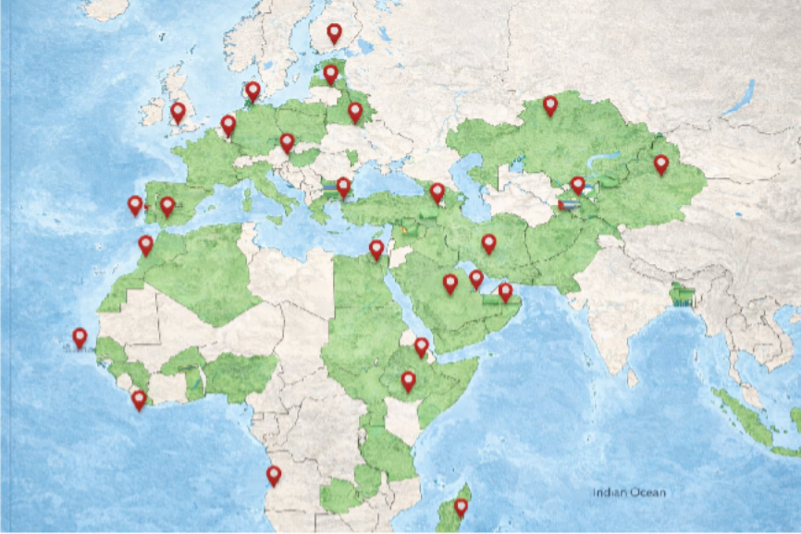
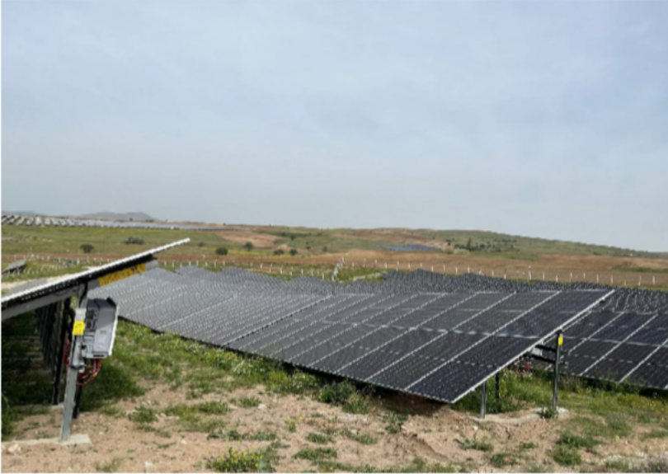
We Are Building the Future Together
Corporate Transformation
Today: Second-Generation Le
Under the leadership of Akın Akay, we are advancing toward our IPO goal through our corporate transformation program.
With solar power supporting sustainable production—alongside consistent quality and fast supply—we uphold the highest standards.
1999: Foundation & Vision
Founded by Dr. Adnan Akay, Onur Plastik entered the industry as a premium manufacturer of PPRC pipes and fittings. Since 2000, we have produced our own molds, achieving fully independent manufacturing capability.
Today, we offer a broad product range with 175 molds and 325 product types.
With solar power supporting sustainable production—alongside consistent quality and fast supply—we uphold the highest standards.
Our energy generation facility was established to minimize our carbon footprint and produces 1 megawatt of uninterrupted power across a 36-decare site.

Slide 6
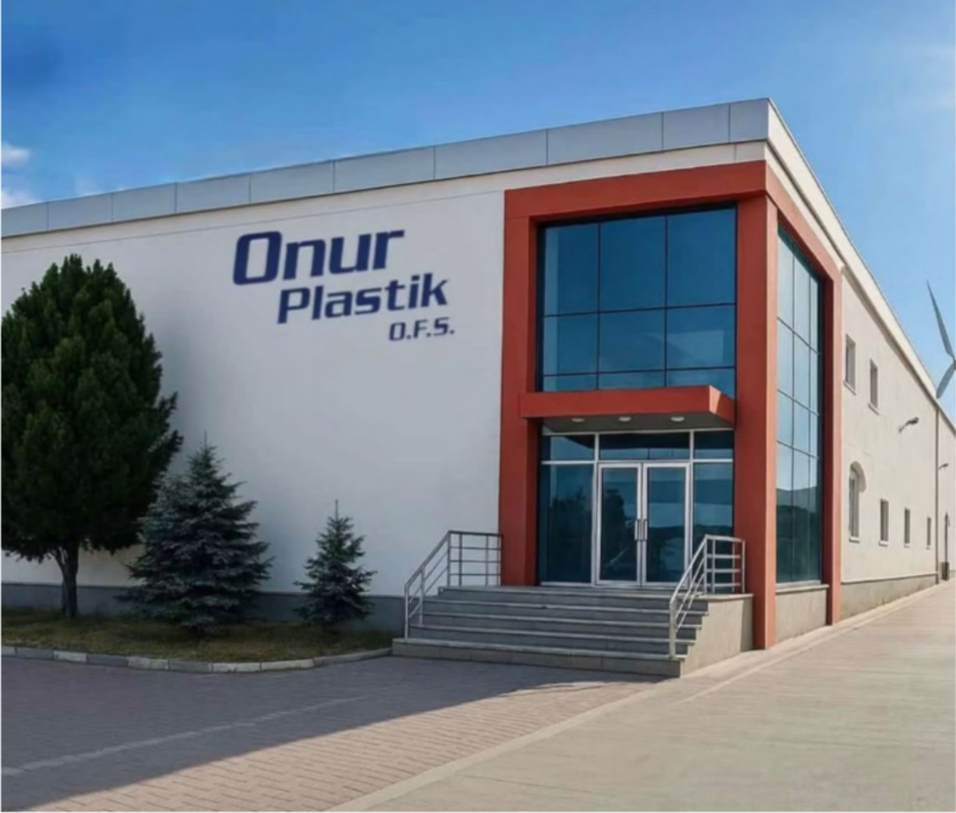
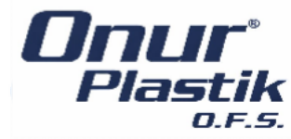
Our Factory & Offices
Our facilities cover a total area of 13,000 m², including:
5,000 m² production area
7,000 m² outdoor area
1,000 m² total office space
We are located in
Velimeşe Organized Industrial Zone (OIZ), Ergene/Tekirdağ.
We also have:
•a sales office in Avcılar, Istanbul
•a logistics office in Sefaköy, Istanbul

Slide 7
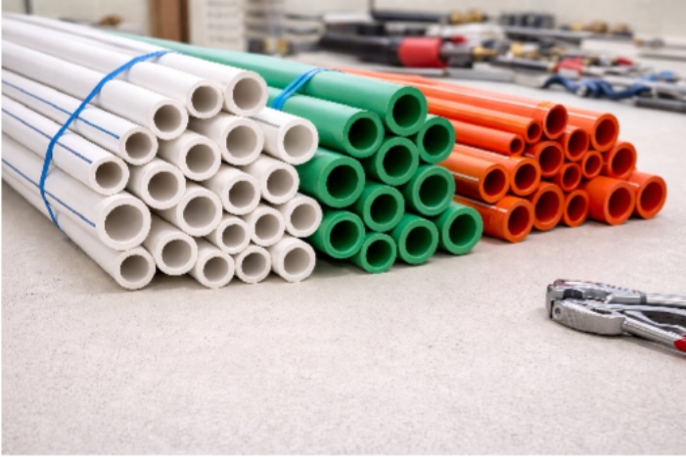
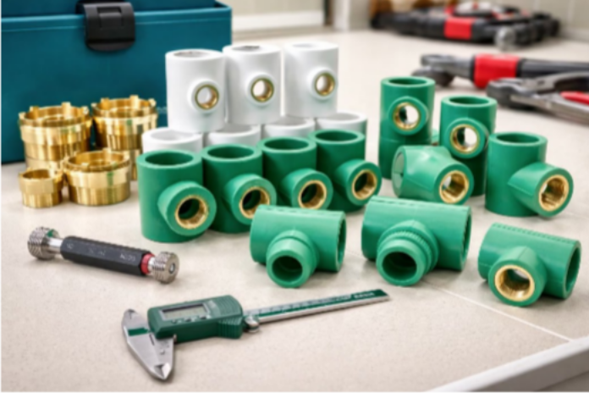
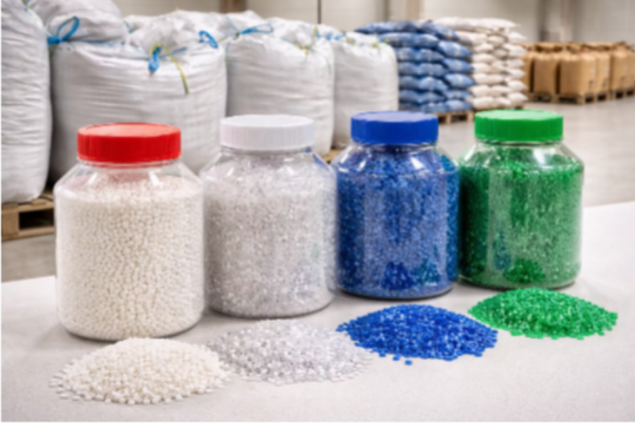
OUR PRODUCTION CAPACITIES
PIPES
We produce an annual average of 1,825 tons of pipes.
FITTINGS
We produce 365 tons of fittings per year.
RAW MATERIAL
We process an annual average of 365 tons
of raw material.

Slide 8
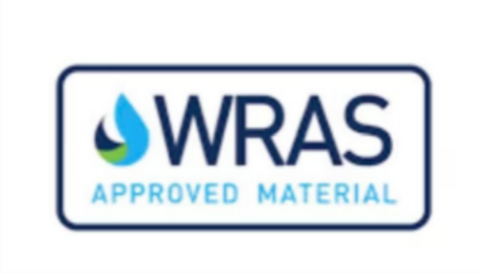
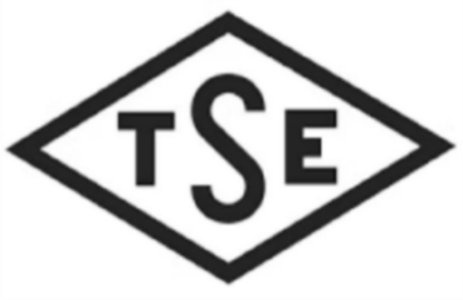
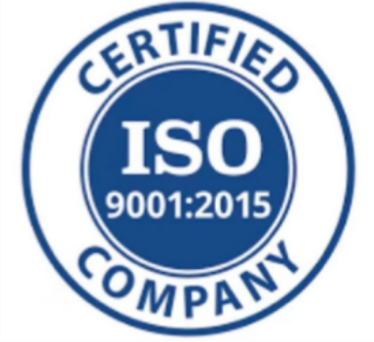
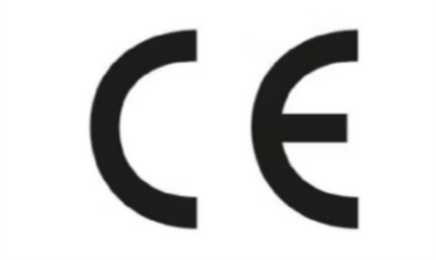
Our Certifications
Wras Approved Material Certified
It demonstrates that the products and materials in contact with water meet the required quality standards.
Certified by the Turkish Standards Institution (TSE)
It is a certificate of conformity with Turkish standards.
ISO 9001:2015
Certified
It is the ISO 9001:2015 Quality Management System Certificate.
CE (Conformité Européenne) Certified
It is a certificate of conformity with European standards.

Slide 9
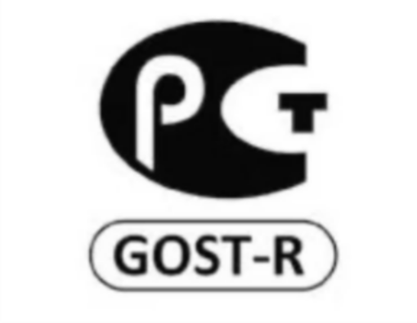
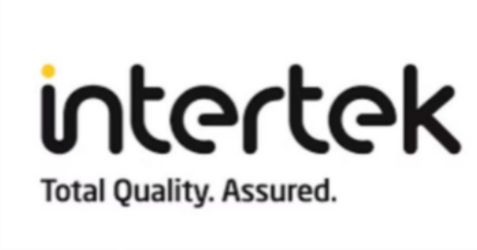

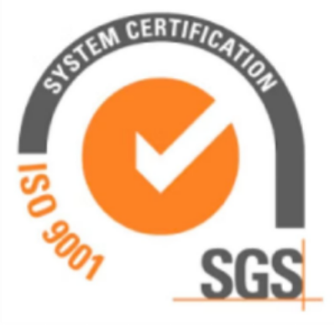
GOST-R
Compliance Certified
It is a certificate of conformity for products manufactured in Russia or exported to Russia.
Intertek — Total Quality. Assured.
It is a certificate of conformity demonstrating that your products and services meet all relevant national and international standards.
Standards Organisation of Nigeria (SON)
It is a certificate of conformity issued under the Standards Organisation of Nigeria, confirming that imported products comply with Nigeria’s technical regulations and standards.
SGS Certified
For exports to Iraq, it is a Pre-Export Conformity Assessment certificate required for certain product groups.

Slide 10
